Slide 1
CURRICULUM LEADERS
November 2, 2022
Topeka, KS

Slide 2
WIFI
Network: Hotel Topeka
Password: Spring22!

Slide 3
SESSION ACTIVITIES & OBJECTIVES
Activities
10:00-11:30 - Discuss The Data
11:30-12:30 – KESA: Perception vs. Reality
12:30-1:30 – Program Managers & Early Literacy Updates
1:30-2:00 – Format and Goals Moving Forward
Objectives
Focus Direction: Are we moving in the right direction?
Cultivate a Culture of Collaboration

Slide 4
MIX-PAIR-SHARE
When the music starts, mix around the room.
When the music stops, greet a partner.
Share the following:
  Current Role/District
  What is your favorite thing about being a curriculum leader?
When the music starts, mix around the room.
When the music stops, greet a partner.
  Current Role/District
  What you hope to accomplish today?

Slide 5

Our Vision for Kansas ...
Kansas leads the world in the success of each student
Notes:
Our business cards will stand out as innovative and memorable with a vertical or portrait orientation. Bonus it has a back side!
a portrait or vertical design. It’s also two-sided!
Another fundamental change you may notice (if not you will after I tell you) is that the main address for our agency has been simplified to the main desk in Suite 102. As all our mail is sorted in the print shop having everything labeled by a different team name and suite only made sense to us as we're used to it. It is less confusing and complex for those we serve.

Slide 6
Kansas State Assessment Performance Correlated with Graduation Rates and Postsecondary Effective Rates
2017 and 2018 10th Graders (Approximately 70,000 Students)
English Language Arts & Math
ELA – Graduation Rate
Math – Graduation Rate
ELA – Postsecondary Effective Rate
Math – Postsecondary Effective Rate
Level 1 (Bottom)
Level 1 (Top)
Level 2 (Bottom)
Level 2 (Top)
Level 3 (Bottom)
Level 3 (Top)
Level 4 (Bottom)
Level 4 (Top)

Slide 7
Kansas State Assessment Performance Correlated with Mean ACT Scores
2017 10th Graders
English Language Arts & Math
ELA – ACT Mean Score
Math - ACT Mean Score
Level 1 (Bottom)
Level 1 (Top)
Level 2 (Bottom)
Level 2 (Top)
Level 3 (Bottom)
Level 3 (Top)
Level 4 (Bottom)
Level 4 (Top)

Slide 8
Discussion Questions…
What are your big takeaways from looking at this data?
What does the data tell you about students in the different performance levels?

Slide 9
Kansas State Assessment Performance
2017 and 2018 10th Graders
English Language Arts & Math
ELA Percentages
Math Percentages
Level 1 (Bottom)
Level 1 (Top)
Level 2 (Bottom)
Level 2 (Top)
Level 3 (Bottom)
Level 3 (Top)
Level 4 (Bottom)
Level 4 (Top)

Slide 10
Kansas State Assessment Performance
2017 and 2018 10th Graders
English Language Arts (68,240) & Math (68,356)
ELA Total Numbers
Math Total Numbers
Level 1 (Bottom)
Level 1 (Top)
Level 2 (Bottom)
Level 2 (Top)
Level 3 (Bottom)
Level 3 (Top)
Level 4 (Bottom)
Level 4 (Top)

Slide 11
Kansas Assessment Program
Performance Level Descriptions for Kansas State Assessment
Level 1: Limited
Level 2: Basic
Level 3: Effective
Level 4: Excellent
Ability to understand and use skills and knowledge needed for postsecondary readiness.

Slide 12
Discussion Question
Is the number of students who demonstrate academic limitations a fundamental problem for our state?
When you think about the Kansans Can Vision, are we achieving our vision based on this data?

Slide 13
Focusing Direction
What would it mean if we mobilized to move kids out of Level 1?
What would it mean if we mobilized to address and account for academic limitations of students?
How can KSDE best support this work across systems in KS?
What can we do as curriculum leaders to support this work across the state?

Slide 14
Focusing Direction
How can KSDE best support this work across systems in KS?
What can we do as curriculum leaders to support this work across the state?
Are there things we would need to stop doing?
Are there things we would need to start doing?
Even when the goals are the right ones, they may not be experienced as connected ideas by the users (Fullan & Quinn, 2016).

Slide 15
Accreditation & Design
Curriculum Leaders
11.2.22

Slide 16

Perception vs. Reality
2 Truths & a Lie
Write out three statements about yourself; two that are true, one that is false.
At your table, each person shares their three statements and the others try to guess which one is false.
Notes:
Jay
Here are some options:
2 Truths and 1 Lie activity: (Perception vs. Reality)
Each participant writes out 2 truths and 1 lie about themselves
In groups of 4 (made up of people from different districts), have each participant share their truths/lie and others must guess which one is false
After each table finishes, ask for those who’s lie was not guessed. Ask for one volunteer to share their’s for the room to guess.
Connection - people use perceptions to make judgements, sometimes affirmed and sometimes contradictory. Living in a time where perceptions often don’t match reality, even when reality is staring them in the face. perpetuated by fake news, social media. How many of you have dealt with someone this school year who had a wild perception about your district or school that was completely unfounded?
Today is about taking a sample of perception data and referencing it with real data to know the truth at a deeper level and to be able to anticipate and get out ahead of people’s false perceptions

Slide 17
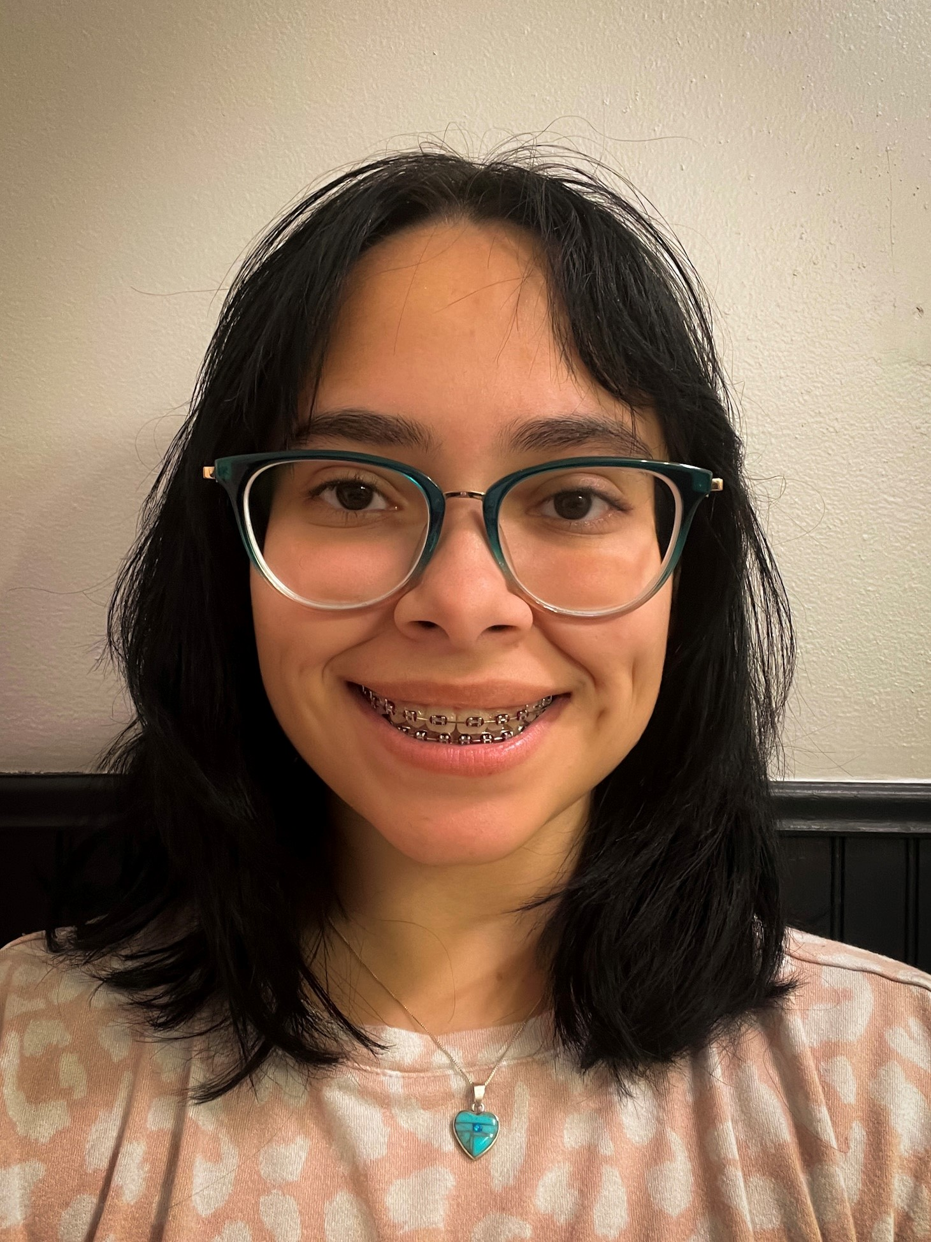
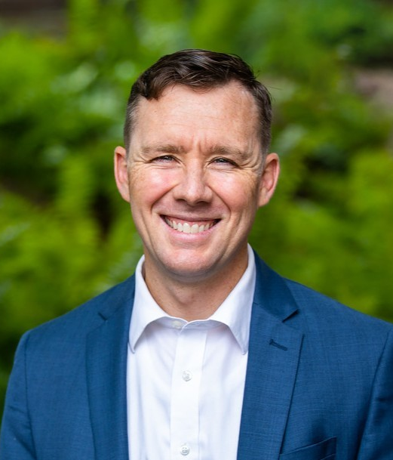
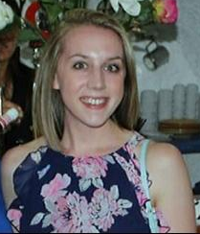
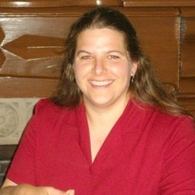
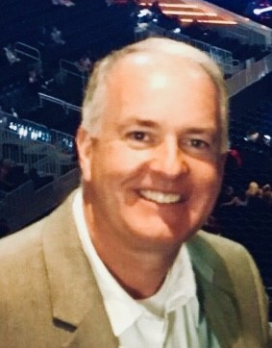
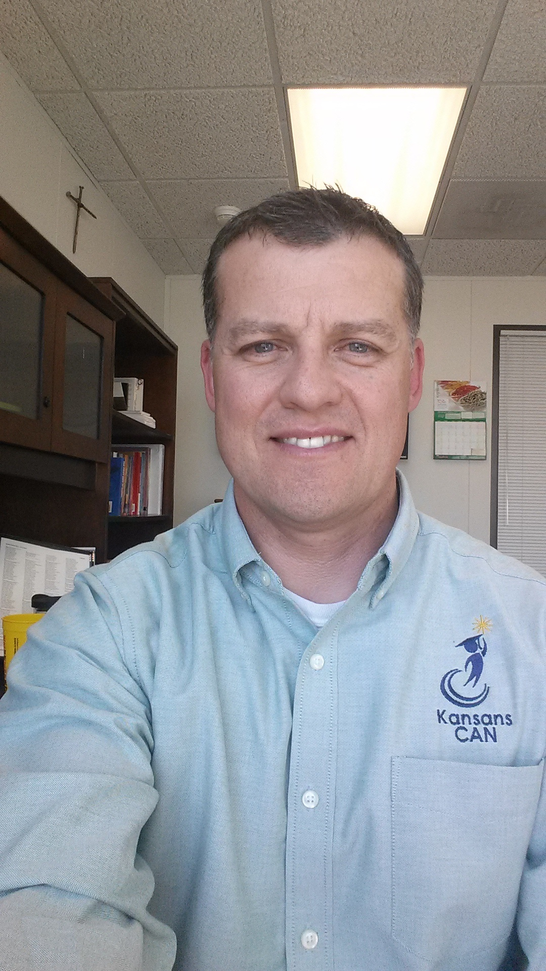
Accreditation & Design Team
Andrea Pagán, Administrative Specialist
Jake Steel, Special Projects
Sarah Perryman, Coordinator
Catherine Chmidling, Assistant Director
Myron Melton, Assistant Director
Jay Scott, Director
Notes:
Jay

Slide 18
Accreditation & Design Team Mission
Within a system of accreditation and design, provide accountability along with support to move systems toward ensuring the success of each student.

Slide 19
What is a Comprehensive Needs Analysis?
https://bit.ly/3zrEWdi
Alignment to the vision
Quantitative and qualitative
Wide-range of stakeholder input
Identifies the root causes
Root cause leads to Goals
Defines current state and informs the path you take to get to the desired state.
Potential Data Sources:
System Accountability Report
Component Baseline Analysis (CBA)
Star Recognition Rubrics
KCTC
Locally developed surveys
Kansas Assessment Program
Formative data (ex. Fastbridge, MAP)
Indicator data (absenteeism, office referrals, climate/culture measures, student engagement, etc.)
Disaggregate Your Data!
Informs and Informed by the Legislated Building Needs Assessment

Slide 20
Real Data

Slide 21
Kansas State Assessment Performance Correlated with Graduation Rates and Postsecondary Effective Rates
2017 and 2018 10th Graders (Approximately 70,000 Students)
English Language Arts & Math
ELA – Graduation Rate
Math – Graduation Rate
ELA – Postsecondary Effective Rate
Math – Postsecondary Effective Rate
Level 1 (Bottom)
Level 1 (Top)
Level 2 (Bottom)
Level 2 (Top)
Level 3 (Bottom)
Level 3 (Top)
Level 4 (Bottom)
Level 4 (Top)

Slide 22
Perception Data

Slide 23

Component Baseline Analysis
https://bit.ly/3zrEWdi
What is it?
Perception Survey
Who takes it?
All Certified Staff/Administrators
How do you administer the survey?
Via a Qualtrics Link (Preview Items)
How do I get my data?
Email accreditation@ksde.org
How can I learn more?
KESA Perception Surveys

Slide 24
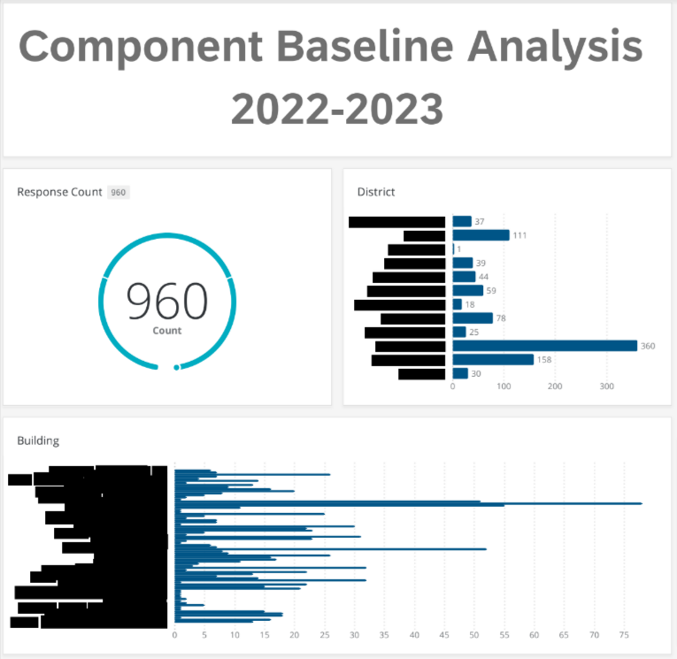
State CBA Results
https://bit.ly/3zrEWdi
960 Responses
11 Districts
360 from 1 System
600 from 10 Systems

Slide 25
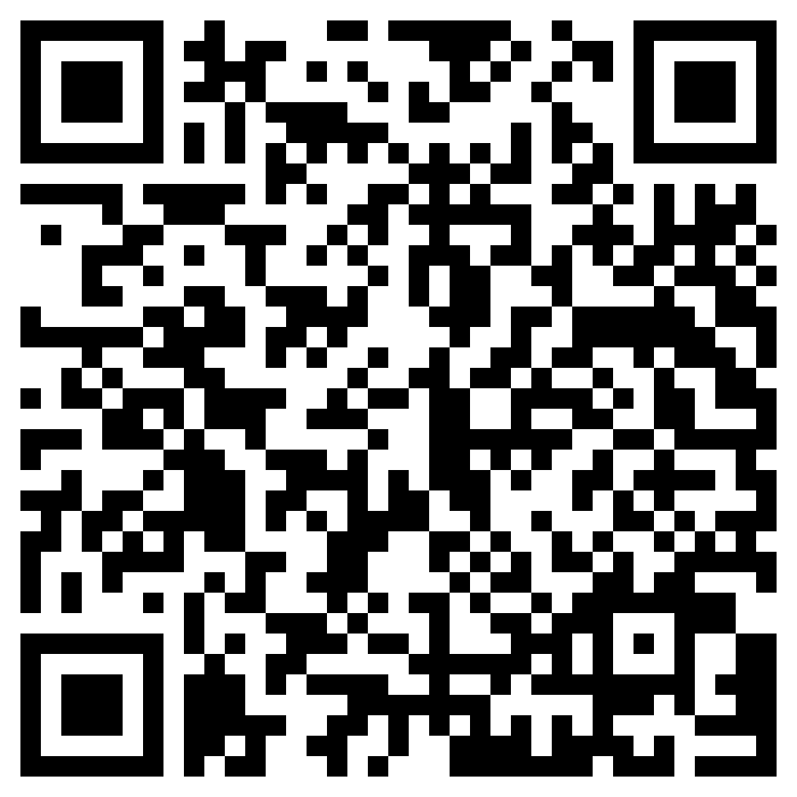
State CBA Results -
Highest Levels of Agreement
State Board Outcomes – Across the district, graduating high school is a priority and goal for every student and staff member across our district.
Leadership and Culture – We have a shared understanding of the vision/mission related to student success.
Data Based Decision Making – We support the process of using data to inform instruction.
Foundational Structures – We provide a diverse, equitable, and inclusive education for all students.
Design Principles – We support the continuous development and integration of both academic and social emotional skills for all students.
Curriculum, Instruction, and Assessment – We implement a curriculum that is fully aligned with the current Kansas standards.
Notes:
https://drive.google.com/file/d/14ArNh47ejZ2thhR2VtJrT8Efk7AwYKUq/view?usp=share_link

Slide 26
State CBA Results -
Lowest Levels of Agreement
https://bit.ly/3zrEWdi
State Board Outcomes – Across the district, students, families, and the school work together as students move our schools to build, adjust, and implement individual plans of study.
Leadership and Culture – We believe all staff have confidence in the capabilities of each other.
Data Based Decision Making – Our data is openly shared, and implications are discussed at multiple levels within the school, with families, and the community.
Foundational Structures – We support increased student appreciation of the arts and cultural heritage.
Design Principles – We support personalized learning for students by providing choice in time, place, path, pace and demonstration of learning.
Curriculum, Instruction, and Assessment – We provide direct instruction to support social and emotional skills.

Slide 27
Perception vs. Reality

Slide 28

Data that confirms/affirms data point.
https://bit.ly/3zrEWdi
Prioritized Data Point-
Problem Statement-
Data that challenges/ contradicts data point.
Notes:
On poster paper and also on the diagram above, districts will:
MAKE A COPY OF THIS SLIDE
Draw out a fishbone diagram on large poster paper
Choose 1 data point to analyze
Add the data point to the head of the fishbone diagram
Identify qualitative data and/or quantitative data that are possible causes of the data point: list those that affirm the data point on top side of fishbone diagram & those that contradict on the bottom.
Add additional causes that affirm or contradict the data point from other sources (quantitative data, local survey data, CTC, etc.)
Create a problem statement based on the data point and the causes listed and add it to the tail of the diagram.
Have one team member record the data point, causes, and problem statement on the diagram above.
Be ready to summarize what you learned from this activity.

Slide 29
Fishbone debrief
What about this process of analyzing data was most useful to you? Why?
What was challenging about this process?
If you were to start this process with the rest of your staff, what would be important to keep in mind?

Slide 30

After analyzing perception and real data…..
Identify problem statement
Root cause analysis
Identify goal
Resources - KESA System Process Information

Slide 31
  Accreditation and Design Team
  (785) 296-8012
  accreditation@ksde.org

Slide 32
KESA
Needs Assessment

Slide 33
KSDE Dyslexia Initiatives
Curriculum Leaders/ Update (11.2.22)
Dr. Laurie Curtis

Slide 34
Early Literacy/ Dyslexia Team
Field Educators (FEs)
Teacher Leader Consultants (TLCs)
Sam Cool
Mary Larkin
Katie Orr
Deanna Frost
Taylor Fegan
Hailey Hawkinson
Melissa Brunner
Jeri Powers
Amy Bybee

Slide 35
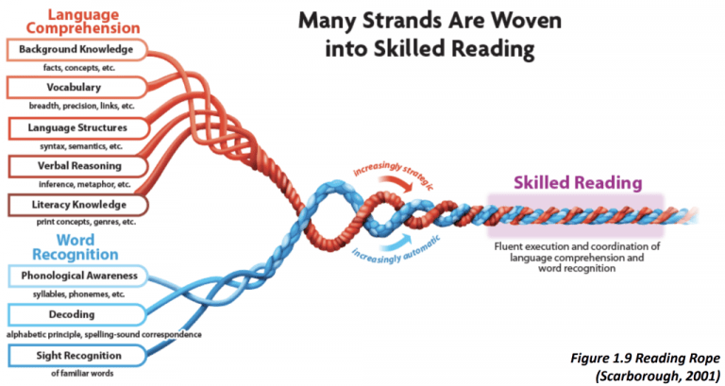
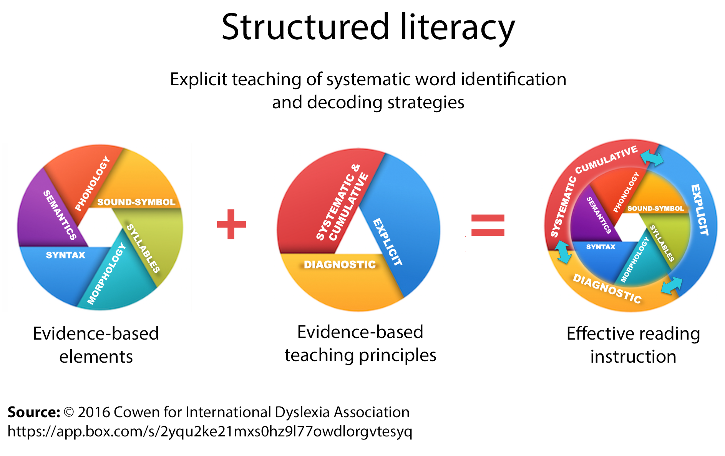
Theoretical Foundation for Practice
The Simple View of Reading
Reading Comprehension
Skilled Reading
Word Recognition/
Decoding
Language Comprehension
Gough & Tunmer, 1986
Notes:
This is not changing. Research supports these models to guide our practice.

Slide 36
Screening, Training, Reporting Requirement
Every student (K-12) is to be screened 3 times per year as required in the Dyslexia handbook.
This universal screening does not identify if a child has dyslexia- but identifies that a child is at risk for reading difficulties and further assessment is needed.
Notes:
This is how it is NOW

Slide 37
Screening, Training, Reporting Requirement
6 hrs of required dyslexia training + Annual Structured Literacy Training (SO66)
endorsed elementary education.
endorsed early childhood unified.
endorsed high incidence special education in teaching in grades K - 12.
endorsed English Language Arts grades 5 - 12.
endorsed as reading specialists.
endorsed as school psychologists.
and it is highly recommended that paraeducators receive the training.
Notes:
This won’t be changing- but reporting will appear in two questions on SO66 next year

Slide 38
Screening, Training, Reporting Requirement
Spring data are to be uploaded into KIDS
Kindergarten: Phoneme Segmentation
1st Grade: Nonsense Word Fluency
2nd Grade: ORF- (rate and accuracy)
Notes:
This will remain the same. Other data collected should be guiding instructional practices in buildings/ districts

Slide 39
Streamlining of Screening Process
The screening “Crosswalk” has been reviewed
The difficulty of screening for certain subskills at certain times of the year has been noted as problematic and expensive
Instruments need to be true screeners:
  nationally normed, valid and reliable
  provide the subtests which were voted upon by the SBOE
  KIDS spring data would still need to be available for K,1,2
  districts would be encouraged to follow the technical manual for administration of subtests as instrument guides- to have useful/ valid data
Notes:
This is what we are considering as a change

Slide 40
Middle/ Secondary Response
A need for review of screening process
A need for professional learning and delivery models
Research review
Action research/ data alignment
Discussion scheduled for proposed changes for secondary screening protocol
Tier 1 Support for Students in Middle/ Secondary: Dyslexia
Jan. 23, 2023 Keystone: Ozawkie, KS
Jan. 30, 2023 SW Plains: Sublette, KS
Feb. 6, 2023 NKESC: Oakley, KS
Feb. 27, 2023 Smoky Hill: Salina KS
Notes:
This is what is new and responsive- we are considering for change

Slide 41
Opportunity for 2nd Grade Assessment
Brief assessment used to inform classroom instruction (in development)
A “bridge” assessment between the instructional focus of early literacy instruction and the expectation of a comprehension assessment more typical of the 3rd grade assessment
Allow schools/ districts to see the effectiveness of core instruction in early grades
Allow schools to see if there are areas to focus on for the shift from learning to read- to reading to learn
Notes:
May take out depending on what Beth finds out due to timing

Slide 42
Literacy Advisory Council
Bylaws initially drafted
Participants identified:
  all regions of the state
  all sizes of districts
  various roles and perspectives
Meetings held quarterly or as needed
Purpose to assist SBOE with information from the field and provide insight and perspective for KSDE’s work
Notes:
Hope to start meeting this winter

Slide 43
Professional Learning
Text-based PD A Fresh Look at Phonics, 6 weekly session (now through December 7, 2022)
90 Minute Literacy Block (November 14: Scott City; December 16, Mankato)
Structured Literacy Walkthrough Tool (soon available on Early Literacy/ Dyslexia website)
Middle/ Secondary Students with Characteristics of Dyslexia (January- February)
Facilitated Conversations for Professionals- Shifting from balanced literacy to structured literacy
Dr. Suzanne Adlof (2, 1 hour webinars) related to language development/ dyslexia/ strategies for intervention- January, 2023
Notes:
How I can help- Professional Learning

Slide 44

KSDE Dyslexia Initiatives
Dyslexia Handbook- revision in process
Information for Kansas Initiatives- updates will be coming See: KSDE Dyslexia Page
Link to the Early Literacy/ Dyslexia Link/ Newsletter
Notes:
Changes will be reflected here

Slide 45
Remain updated via
KSDE Weekly
Listservs (Early Literacy/ Dyslexia)
Stakeholder Meetings
KSDE Dyslexia Webpage
  ELitDyslexia@ksde.org or lcurtis@ksde.org
Notes:
Ways to stay informed.

Slide 46
Laurie Curtis
Early Literacy/ Dyslexia Program Manager
CSAS
(785) 296-2749
lcurtis@ksde.org

Slide 47
Program Managers
Humanities:
ELA – Joann McRell
History/Government/Social Studies – Nathan McAlister
Early Literacy/Dyslexia – Laurie Curtis
STEM
Math/Computer Science – Stephen King
Science – Meg Richard
School Climate/Wellness – Kent Reed

Slide 48
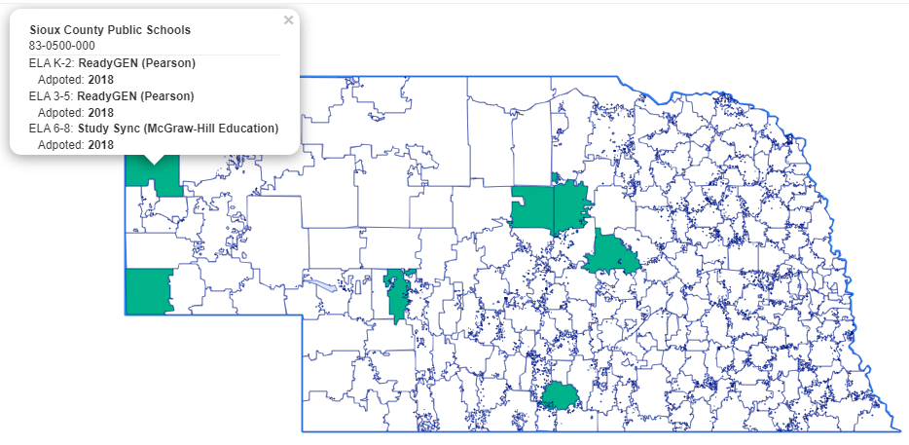
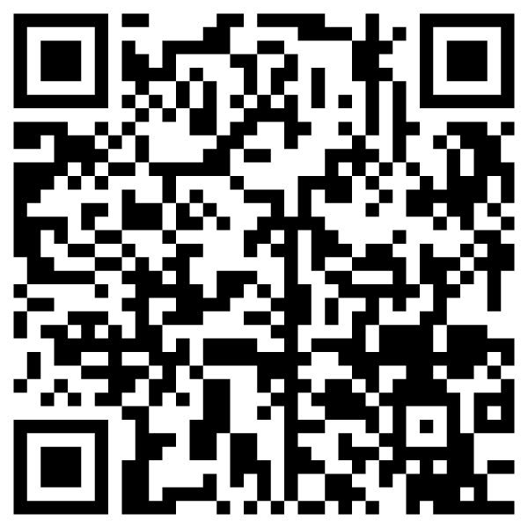
ELA upcoming projects
High Quality Instructional Materials (HQIM)
need database of current leaders for ELA reading curriculum (core only)
please complete this link to assist us in contacting the curriculum adoption specialist at your various grade bands
  https://forms.gle/LGWWPj5Dv5h1Cxof8
Notes:
Describe business rules for using each – what are the non-negotiables in terms of design, etc.?
Describe logo usage – when to use KSDE, when to use Kansans Can, using dual logos, etc.

Slide 49
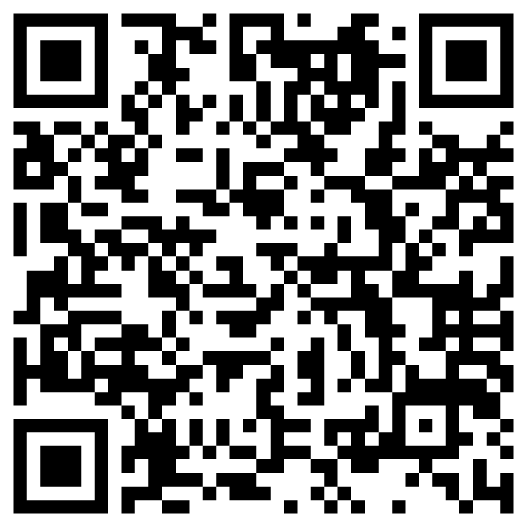
ELA upcoming projects
2024 Standards Revision, K-12
taking nominations now for team
  teachers
  instructional coaches
  curriculum leaders
currently designing schedule, but it will be a combination of virtual and on-site
  https://forms.gle/foyi6j2GgBkdeCis8
Notes:
Describe business rules for using each – what are the non-negotiables in terms of design, etc.?
Describe logo usage – when to use KSDE, when to use Kansans Can, using dual logos, etc.

Slide 50
School Climate/Wellness
School Counseling
Social-Emotional Character Development
Advanced Placement
Pe/Health
Youth Risk Behavior Survey (CDC)
Individual Plan of Study
Mental Health Crisis Triage Team
Kent Reed, Climate/Wellness Program Manager
kreed@ksde.org
785-296-8109

Slide 51
Curriculum Leaders
What format would you like to see for Curriculum Leaders moving forward?
  Next Meeting Dates: January 20 & April 21
What feedback do you have for the KSDE staff based on today’s discussions?

Slide 52
Upcoming Dates
KSDE Summer Academies
The Art of Teaching: Instructional Artistry
June 12-16, 2023 Two locations in western Kansas
July 10-14, 2023 Two locations in eastern Kansas
KSDE Great Ideas In Education Conference
October 25-27, 2023
Wichita Hyatt

Slide 53
  Ben Proctor
  Deputy Commissioner
  Division of Learning Services
  (316)587-5665 (Cell)
  785-296-2303 (Office)
  bproctor@ksde.org

